Slide 1
Linking MIDAS Data with Biological Databases:
An R-Based Pipeline for Protein-Metabolite Discovery
Kainoa Martinez

Slide 2
Table of contents
01
02
03
04
05
06
Introduction
Project Background
Methods
Results
Conclusion
Acknowledgments

Slide 3
01
Introduction

Slide 4




Introduction
Notes:
Introduction:
-Name
-Where I’m from
-Where I went to school / What school I will be attending / major
This summer:
-Who I am working with this summer (co-mentorship from Paul Stewart at the Huntsman Cancer Institute and Kevin Hicks)
And as mentioned in the presentation title, this summer I was tasked with creating a coding pipeline using R to integrate external databases like UniProt and HMDB with MIDAS data for unique user queries and to identify previously annotated interactors and potentially discover novel or unknown protein metabolite interactions. This tool coding pipeline would be helpful for hypothesis generation.

Slide 5
02
Project Background
Notes:
I’m going to give some background information into my project and define some of the terms you will frequently hear throughout!

Slide 6
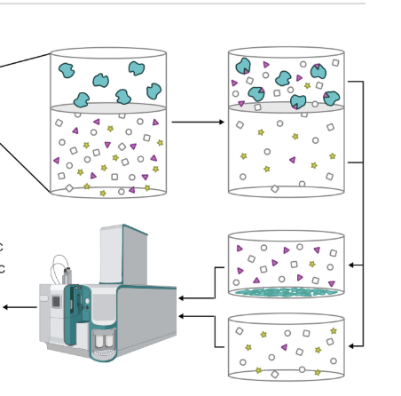
What is MIDAS?
MIDAS (Mass spectrometry Integrated with equilibrium Dialysis for the discovery of Allostery Systematically)
Using mass spectrometry and equilibrium dialysis helps to identify interactions between metabolites and proteins
  Enables systematic identification of protein-metabolite binding events = providing richer interaction profiles
Notes:
So, the title of the presentation is called “linking MIDAS Data with Biological databases”. So, what exactly is MIDAS and why is it important?
MIDAS stands for Mass Spectrometry Integrated with Equilibrium Dialysis for the Discovery of Allostery Systematically. In more digestible terms, MIDAS uses mass spectrometry (analytical technique that measures the mass-to-charge ratio of its ions to identify chemical compositions of a sample) and equilibrium dialysis (a technique used to determine the extent to which a compound binds to a protein) to help identify interactions between metabolites and proteins. And the reason this is important to biological database expansion and PMI discoveries is because MIDAS enables a systematic way to identify these protein metabolite interactions to provide richer interaction profiles.
SO using MIDAS, it helps scientists discover new regulatory roles for metabolites, understand metabolic control at the protein level, and uncover previously unknown biological pathways.
Only talk about if asked about MIDAS process:
Here on the right is a diagram depicting part of the MIDAS process, where purified proteins (the cyan colored nuggets) are placed behind a semi-permeable membrane (grey oval) in the presence of a metabolite mixture. And metabolites can freely diffuse across the membrane, except when they bind to the protein, which traps them on the protein side. After equilibrium, mass spectrometry quantifies metabolite levels on both sides, and enrichment on the protein side indicates a direct binding interaction. SO using MIDAS, it helps scientists discover new regulatory roles for metabolites, understand metabolic control at the protein level, and uncover previously unknown biological pathways.

Slide 7

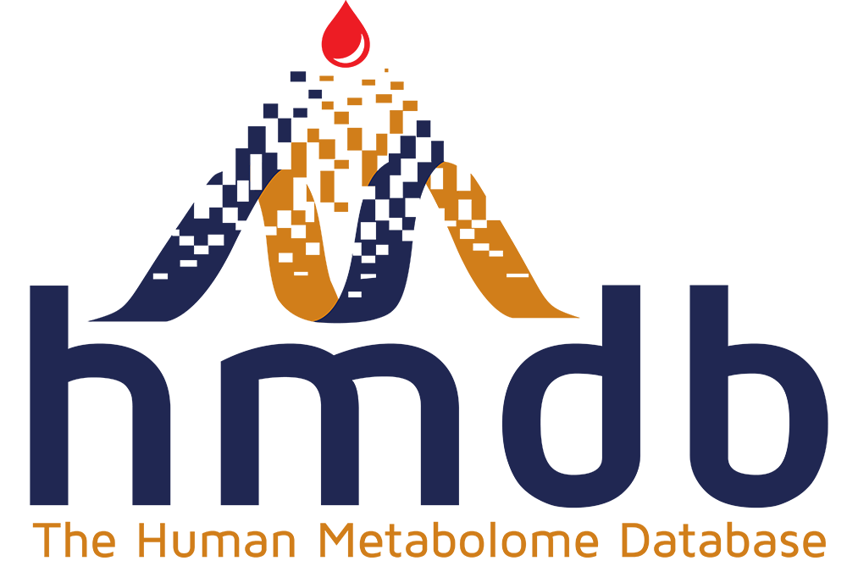
What is HMDB and UniProt?
HMDB - Human Metabolome Database
UniProt - Universal Protein Resource
Notes:
HMDB stands for Human Metabolome Database (Canada), which is just like it sounds-- a database with detailed info about metabolites in the human body.
UniProt stands for the Universal Protein Resource (collaboration between US, UK, Switzerland), which is a comprehensive resource for protein sequence and annotation.
These are the 2 databases I integrated with MIDAS data.

Slide 8
03
Methods
Notes:
Now I will talk about my methods, which is essentially a flowchart showcasing my coding process to integrate HMDB and UniProt with MIDAS data.

Slide 9
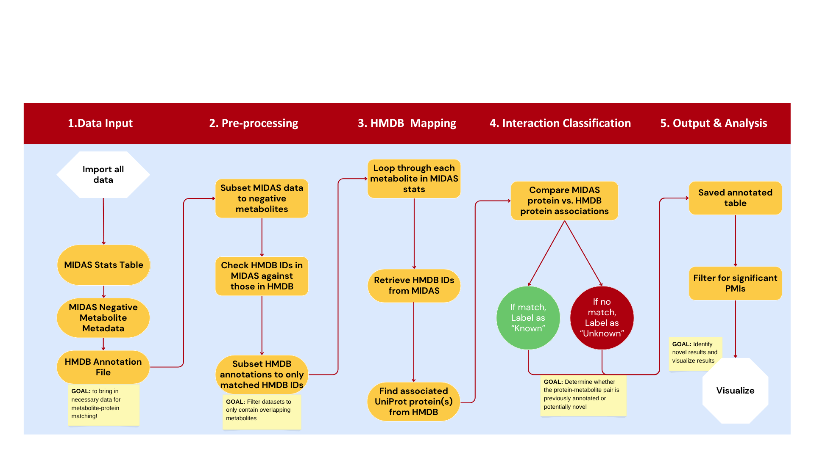
Notes:
In this flowchart, I categorized my work process into 5 sections: data input, pre-processing, HMDB mapping, interaction classification, and output/analysis.
I’m not going to go through all these points, but to summarize the goal of each section, the goal of data input is to simply bring in all the necessary data files for metabolite matching. For pre-processing, the aim is to filter datasets to only retain metabolites that are present in both HMDB and MIDAS. For HMDB mapping, we took the matched HMDB IDs and looped it through each metabolite in MIDAS to find its associated UniProt protein. For interaction classification, the goal was to determine whether the protein-metabolite interactions were previously annotated (known) or potentially novel (unknown). For the last step (output and analysis), I filtered for significant PMIs (which was dictated by a q-value < 0.01 and log2 fold change > 1) and created visuals for these PMIs.

Slide 10
04
Results

Slide 11
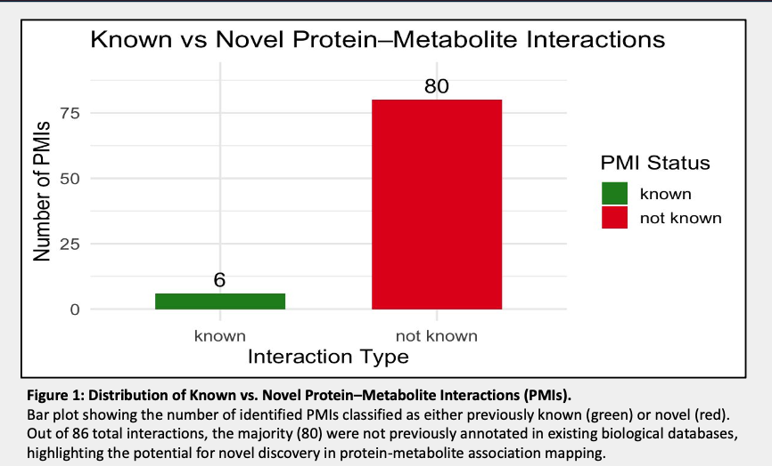
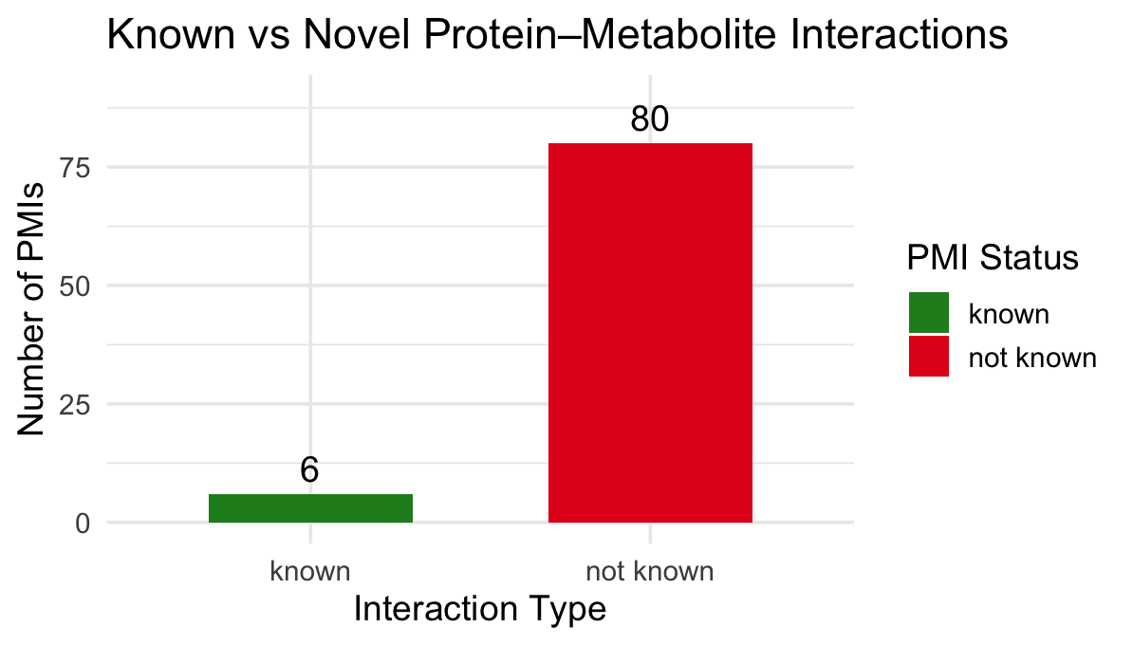
Notes:
In this first visual, we have a bar graph showing the distribution of Known vs Novel Protein-Metabolite Interactions. And as we can see the majority of the PMIs in our dataset appear to be potentially novel, which is great because what this means is that the MIDAS data is uncovering new interactions not captured by existing databases.

Slide 12
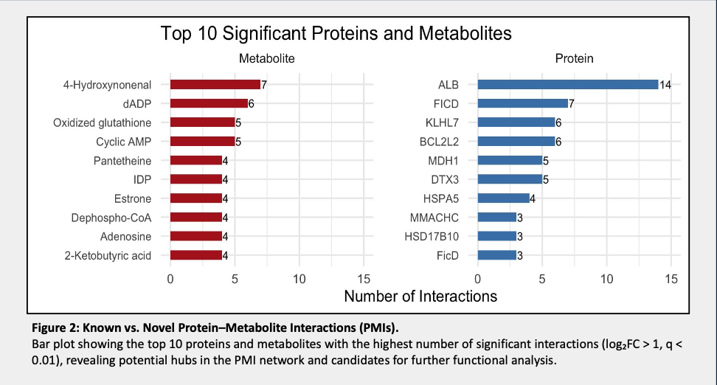
Notes:
In this bar plot, we are seeing the Top 10 significant proteins and metabolites with the most interactions. Most notably, if we look at Albumin, it has the most interactions with metabolites. Because Albumin is well-known to bind a wide range of metabolites and it’s high number of interactions matches the known biology, it can be said that this outcome supports the validity of our MIDAS processing and significance filtering pipeline.

Slide 13
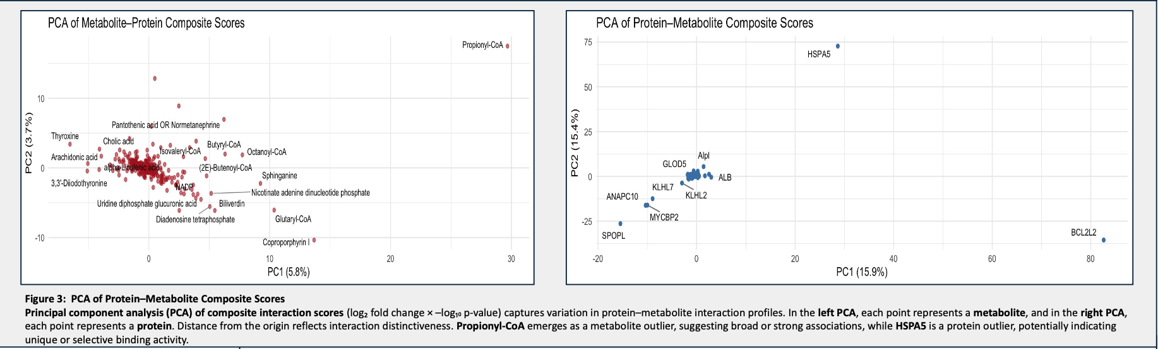
Notes:
In this visual, we have PCAs (or principal component analysis) of composite interaction scores. What we can see here in the left PCA is that there is cluster of CoA’s (Butyryl, Octanoyl, Butenoyl, Isovaleryl) possibly sharing binding behavior with the same protein, or we could infer there might also be CoA regulating several processes. An outlier like Propionyl-CoA could therefore indicate some novel interaction patterns since it is estranged from this cluster.
Shifting to the PCA on the right, we can look at it in a different way, being that we can see Albumin in the cluster of proteins, kind of near the center (indicating typical patterns), so again--the presence of Albumin in our PCA acts as a reliable internal reference, and its expected placement helps confirm that the composite interaction scores and overall pipeline are behaving biologically and analytically as they should.
Extra Info on PCA:
-PCA helps summarize complex interaction data
-Each protein likely has a vector of composite scores for many metabolites. That’s hard to visualize directly, so PCA reduces those dimensions into PC1 and PC2 — two new variables that capture the most variation across all proteins’ interaction profiles.
-PC1 (x-axis) explains 15.9% of the total variation in the dataset.
-PC2 (y-axis) explains 15.4%.
-Each point represents a protein, positioned according to its overall interaction profile across metabolites.
-Proteins that cluster near each other (e.g., ALB, GLOD5, KLHL2) have similar metabolite interaction profiles.
-Proteins far from the main cluster (e.g., HSPA5, BCL2L2, SPOPL) have distinct interaction patterns.
-Composite score is referring to a single value that summarizes both strength and statistical significance of each PMI. So, what we are doing is multiplying the log2 fold change and log of the p-value to capture and combine the magnitude of change and confidence in the result.

Slide 14
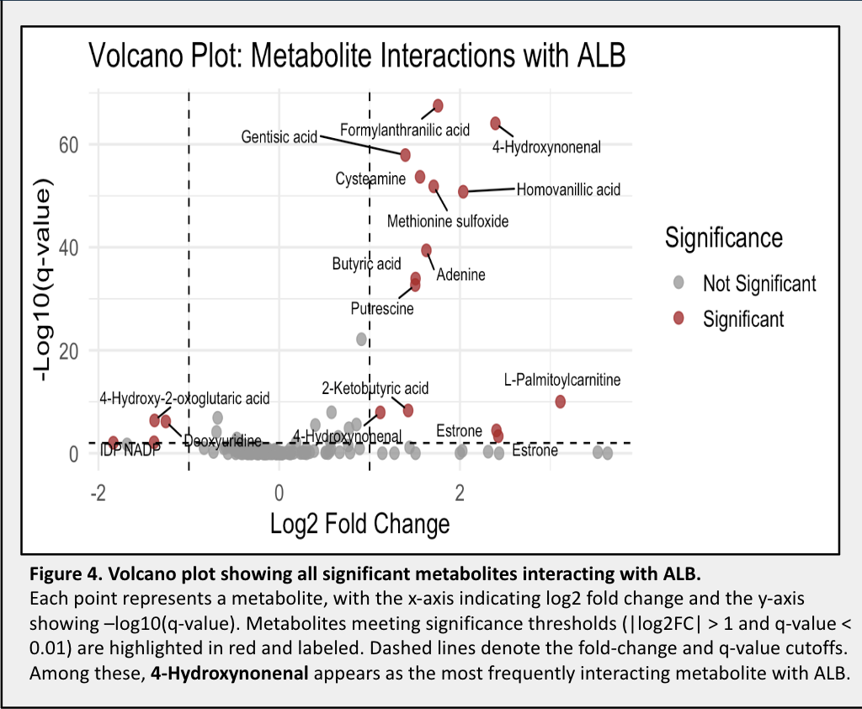
Notes:
This volcano plot further supports the validity of the pipeline as we focus on albumin again (ALB). And as expected, many metabolites do not show statistically significant interactions (gray) with Albumin, while a subset shows significant enrichment (red). This distribution aligns with Albumins tendency to bind broadly but not universally or with high affinity, and the pattern seen here reinforces albumin’s utility as a biological benchmark to support that the pipeline is capturing a realistic interaction profile.

Slide 15
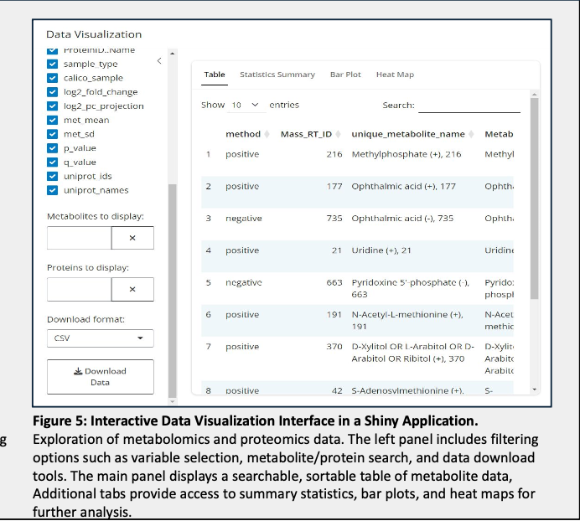
Notes:
Here we have a screenshot of the Shiny app my co-intern McKenna created. I handled the backend of this project, while she worked on the front end, user interface aspect of it, and it provides an interactive platform to explore protein–metabolite interaction data, enabling people to filter, visualize, and interpret datasets in real time. It supports variables like fold change, p-values, and protein/metabolite identities, with built-in visualizations (volcano plots, PCA, heat maps, etc.) that help users identify biologically meaningful patterns without needing to code. This makes the analysis more accessible, reproducible, and customizable for different research questions.

Slide 16
05
Conclusion

Slide 17
Conclusion
Integrating MIDAS data with HMDB and UniProt annotations reveals a large number of novel PMIs
Most significant PMIs are previously unreported, highlighting the value of this approach in expanding functional annotations
PCA shows distinct clustering of interaction profiles, suggesting biological relevance
The projects future direction aims to incorporate databases like BRENDA and STITCH to enhance the depth of protein-metabolite annotations and allow the framework to handle larger and more diverse datasets
Notes:
Some concluding statements:
We concluded that integrating MIDAS data with HMDB and UniProt annotations reveals that there are a good chunk of novel PMIs within our dataset, so our pipeline isn’t just regurgitating known biology, but it is also capable of discovering new interactions.
We can also conclude that many of these PMIs are previously unreported, which means we are contributing to a deeper understanding of protein function and metabolism.
Additionally, distinct clusters in our PCA mean that proteins and metabolites are interacting in biologically coherent ways—supporting the robustness and interpretability of your pipeline.
And lastly, we hope to incorporate other biological databases like BRENDA (BRaunschweig ENzyme Database--germany) for detailed information about enzymes and also integrate STITCH (Search Tool for Interacting CHemicals--china) for info about protein-chemical interactions, to enhance the depth of PMI annotations, so that later down the line, we can scale this pipeline to tackle larger and more diverse datasets.

Slide 18
06
Acknowledgements

Slide 19



Paul Stewart PhD
Kevin Hicks PhD
McKenna Wilson
Notes:
To Paul and Kevin:
Thank you for giving me the chance to work with you this summer and trusting me to create this tool
-A super great learning experience working with the 2 of you
-I think was also a really great learning experience for me to hone my data skills before heading off to graduate school, but also a humble reminder that I have a lot of room to improve my coding skills, but thank you again for your mentorship and your patience this summer, and I’m very grateful for the both of you
-I’d also like to shoutout McKenna who created the front end of this process, so handling the user interface portion of the Shiny app, and just being a wonderful person to work with this summer

Slide 20
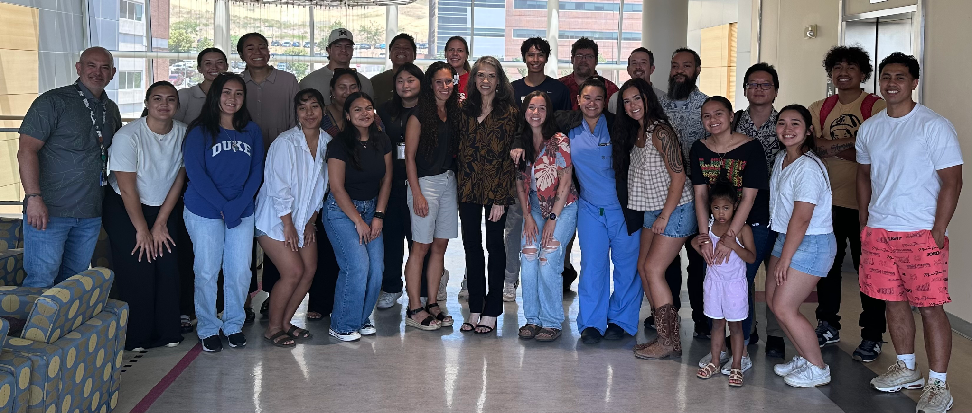

Slide 21

Sources
Hicks, K. G., et al. (2023). Protein-metabolite interactomics of carbohydrate metabolism reveal regulation of lactate dehydrogenase. Science, 379(6636), 996–1003. https://doi.org/10.1126/science.abm3452

Slide 22
Thank
you!
Do you have any questions?
Notes:
Most biomedical databases (like HMDB, UniProt, and others we’re integrating) are heavily biased toward data from populations of European descent. This creates blind spots in understanding disease mechanisms and limits the relevance of research findings for NHPI communities.
Our Vision for Inclusion:
We aim to adapt our protein-metabolite interaction (PMI) pipeline so it can integrate diverse datasets—including those that represent NHPI biological samples—when and where they are available. This would ensure the discoveries our platform makes are inclusive, representative, and potentially useful for addressing health disparities.

